Slide 1

High Impact Skills Development Program
in Artificial Intelligence, Data Science, and Blockchain
Module 3: Data Visualization
Lecture 3: Building Blocks of Visualization
Instructor: Dr. Arham Muslim
Assistant Professor, SEECS, NUST

Slide 2

Lecture 2 – Recap
Resource Limitations
Computational limits
Human limits
Display limits
Visualization Analysis Framework
Why Analyze a Vis?

Slide 3

Today’s Agenda
What? – Data Abstraction
Attribute Types in InfoVis
Why? – Task Abstraction
Building Blocks: Marks and Channels
Expressiveness Principle
Effectiveness Principle

Slide 4

Visualization Analysis Framework
What data is shown?
Data abstraction
Why does the user need it?
Task abstraction
How is it shown?
Idiom: visual encoding and interaction
What-Why-How analysis framework as scaffold to think systematically about design space

Slide 5
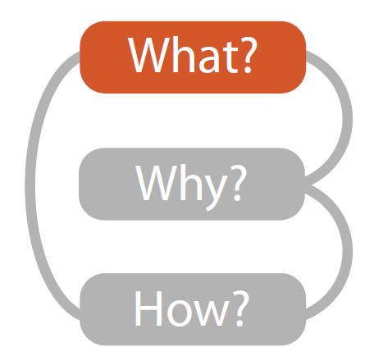
What? – Data Abstraction

Slide 6
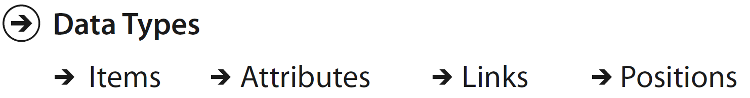
Data Types
An item is an individual entity that is discrete
I.e., a row in a table
An attribute is some specific property that can be measured, observed, or logged.
I.e., a column in a table
Example: student name, registration number, contact number, marks in quiz 1, etc.
A link is a relationship between items, typically within a network
A position is spatial data, providing a location in a space
Example: latitude & longitude

Slide 7
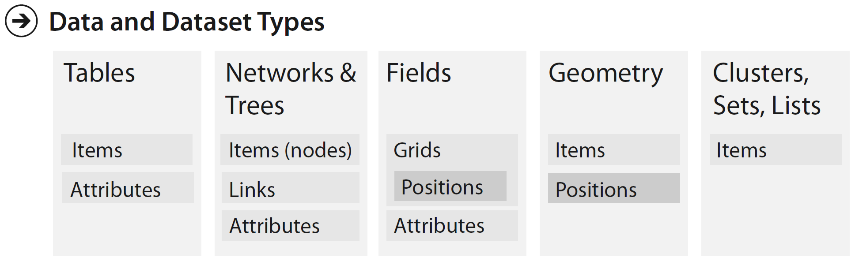
What? – Dataset Types

Slide 8
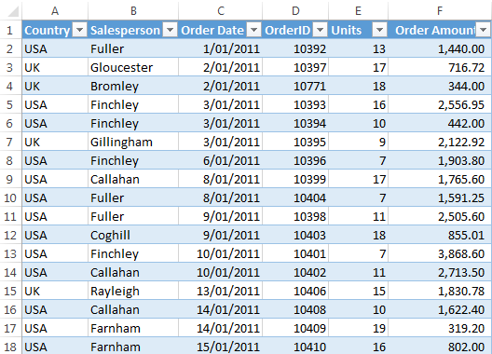
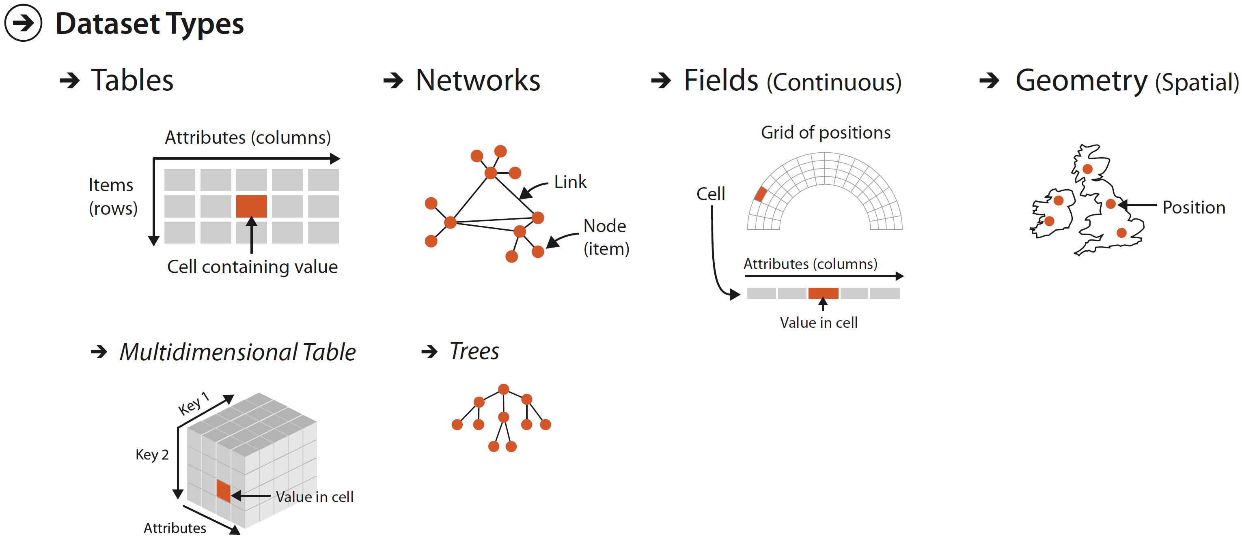
Dataset Types – Tables
Tables are made up of rows and columns
A familiar form to anybody who has used a spreadsheet
Attribute
Cell
Item

Slide 9
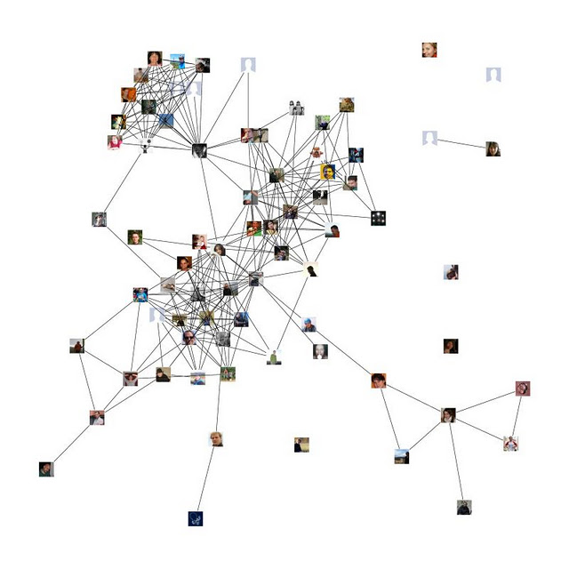
Dataset Types – Networks
Networks contains relationships between two or more items
Facebook Friends Network

Slide 10

Dataset Types – Geometry
Information about the items with explicit spatial positions
The items could be points, one-dimensional lines or curves, 2D surfaces or regions, or 3D volumes

Slide 11
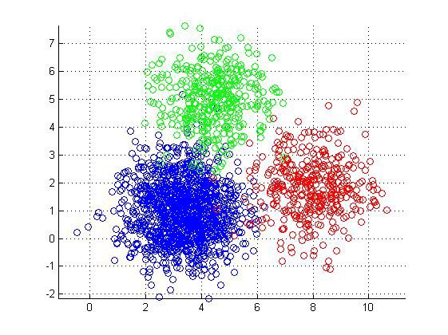
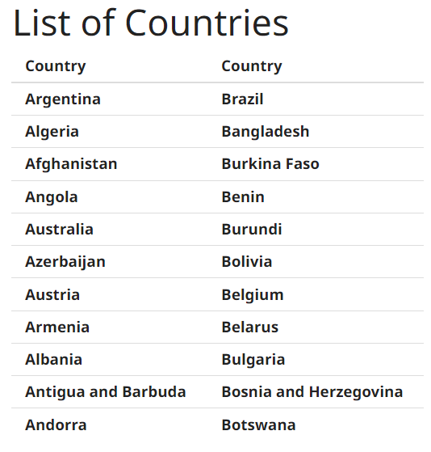
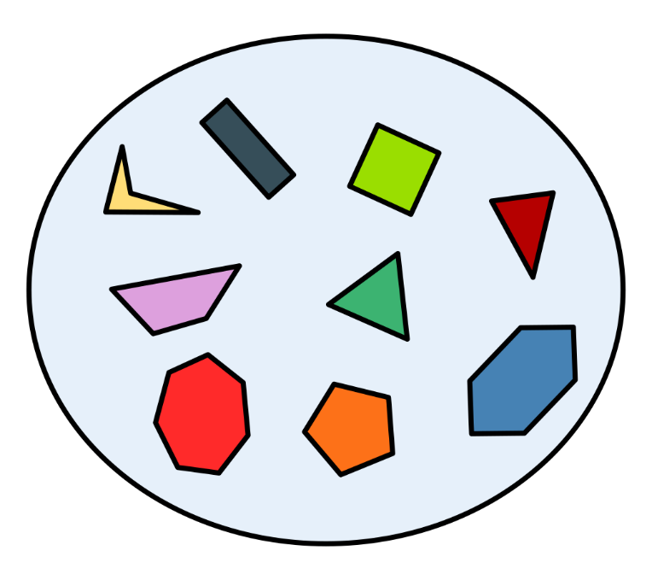
Dataset Types – Sets, Lists, Clusters
A set is simply an unordered group of items
A list is a group of items with a specified ordering
A cluster is a grouping based on attribute similarity, where items within a cluster are more similar to each other than to ones in another cluster

Slide 12
Variables/Attributes in ML
Dataset (sample or table) consists of examples / instances (row in a table)
Variables are often referred to as features / attributes (column in a table)
Two types:
Categorical (discrete) variables
Has only a finite set of values
Ordinal (high-med-low, grades)
Nominal (true-false, color, profession)
Numerical (continuous) variables
Has real numbers as values (e.g. Temperature, height, weight)
Ordered, cannot be enumerated easily

Slide 13
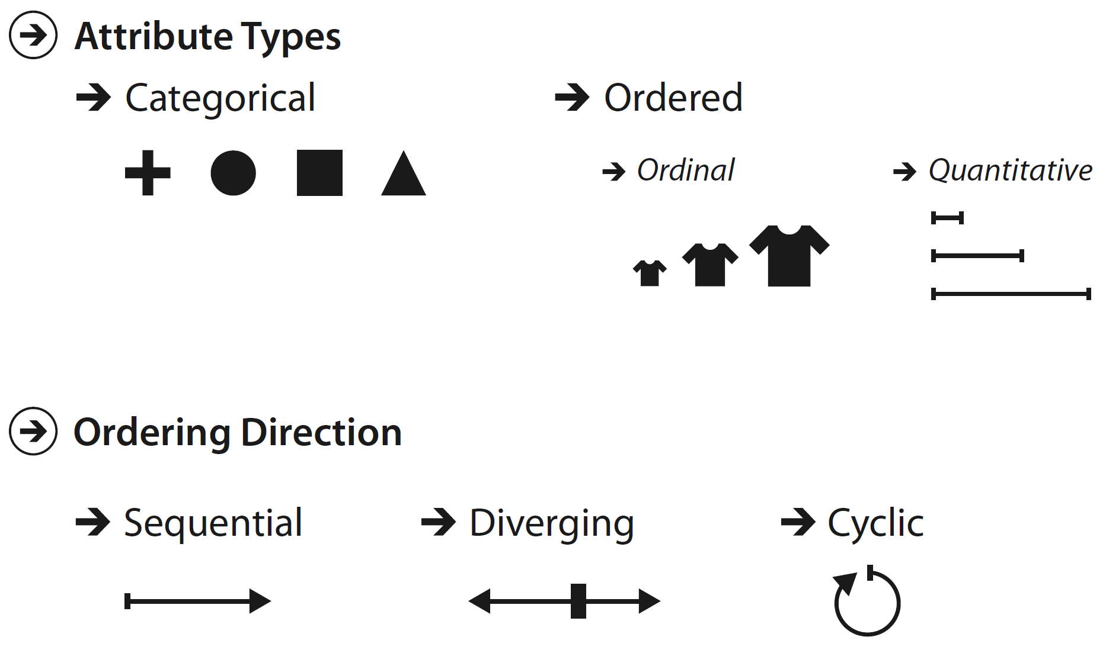
Attribute Types in InfoVis
Categorical
No implicit ordering
Called nominal attribute in ML
E.g., movie genres, file types, city names, fruit name, color names, etc.
Ordered
Implicit ordering
Further subdivided into
Ordinal
Cannot do meaningful arithmetic operation
There is a well-defined ordering
E.g., large-medium-small, good-average-bad, order ids, etc.
Quantitative
Supports arithmetic operations
E.g., height, weight, temperature, stock price, number of drinks sold at a coffee shop in a day, etc.

Slide 14
ML to InfoVis Attribute Mappings
Dataset (sample or table) consists of examples / instances (row in a table)
InfoVis: Items
Variables are often referred to as features / attributes (column in a table)
InfoVis: Attributes
Two types:
Categorical (discrete) variables
Has only a finite set of values
Ordinal (high-med-low, grades)
Nominal (true-false, color, profession)
Numerical (continuous) variables
Has real numbers as values (e.g. Temperature, height, weight)
Ordered, cannot be enumerated easily
=> InfoVis: Ordinal
=> InfoVis: Categorical
=> InfoVis: Quantitative

Slide 15

Why? – Task Abstraction

Slide 16
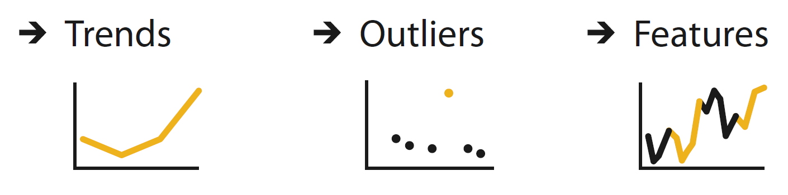
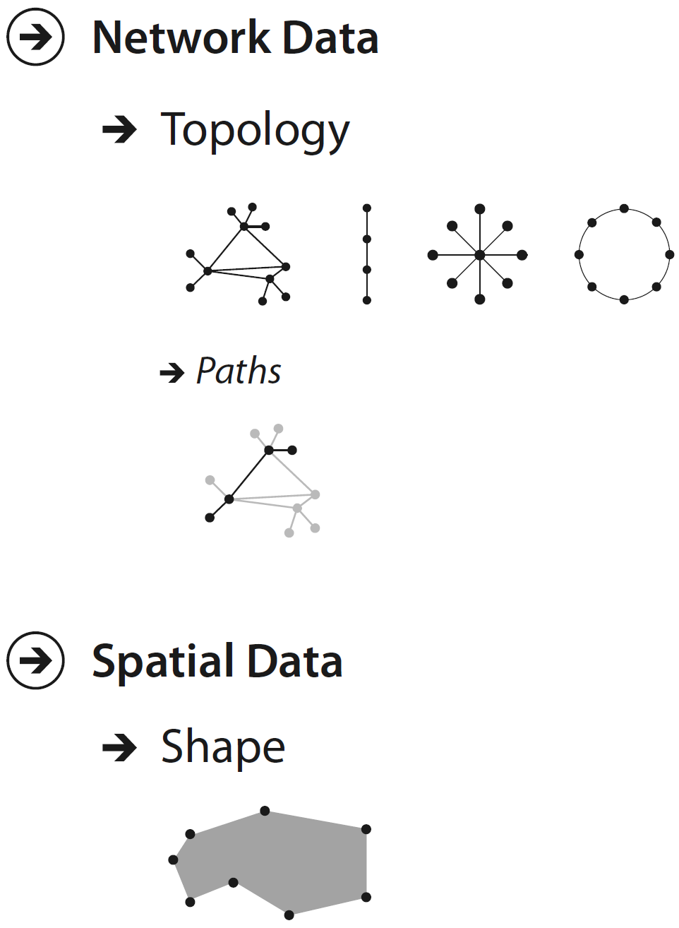
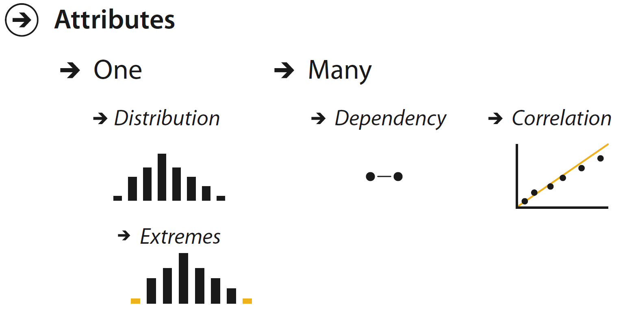
Task Abstraction – Vis Objectives

Slide 17
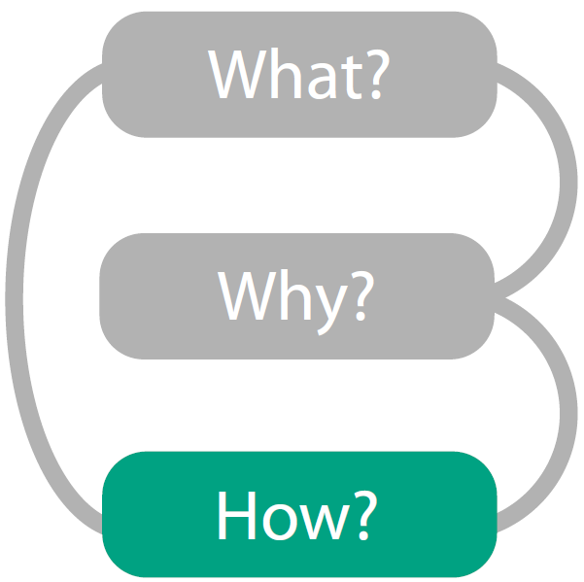
How? – Visual Encoding

Slide 18
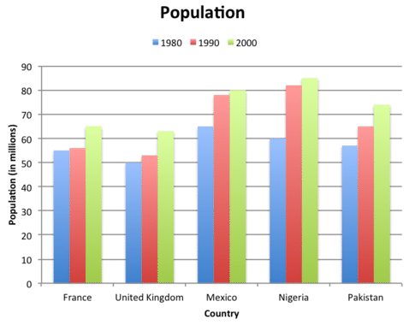
Analyzing a Chart – Revisit
How are items represented?
Bars
How are attributes represented?
Year:
Population:
Country:
Country | Year | Population
France | 1980 | 55
France | 1990 | 56
France | 2000 | 65
United Kingdom | 1990 | 50
Color of bars
Length of bars
Position of bars on x-axis

Slide 19
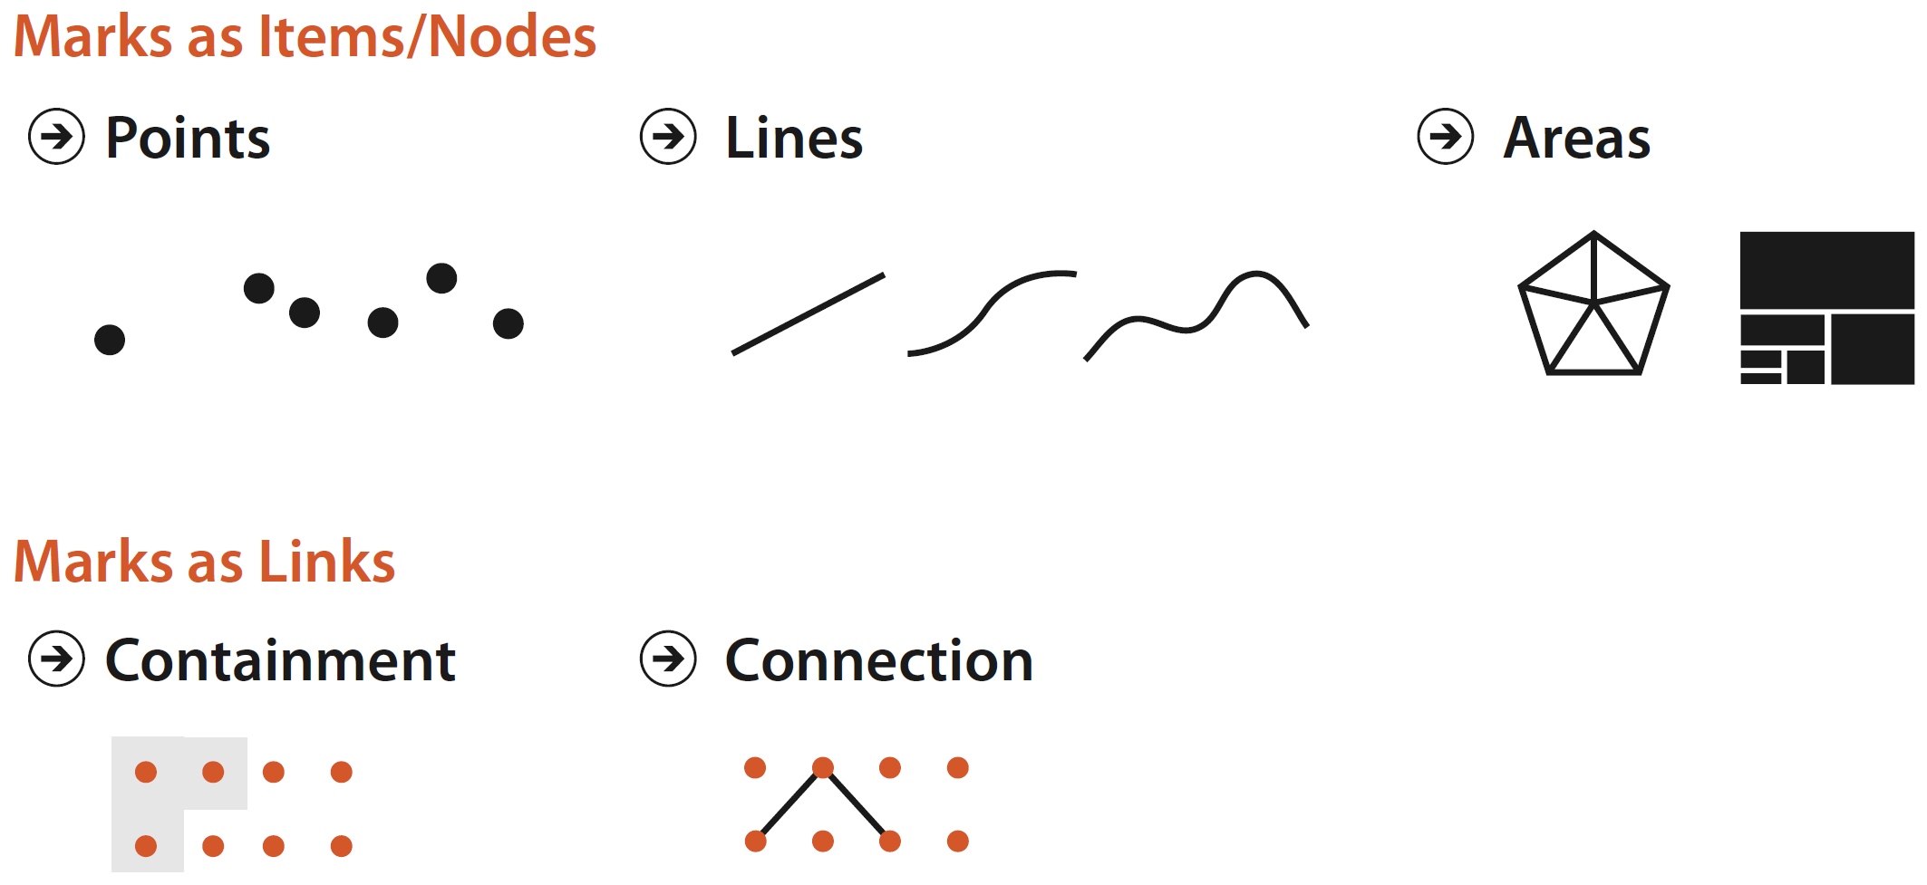
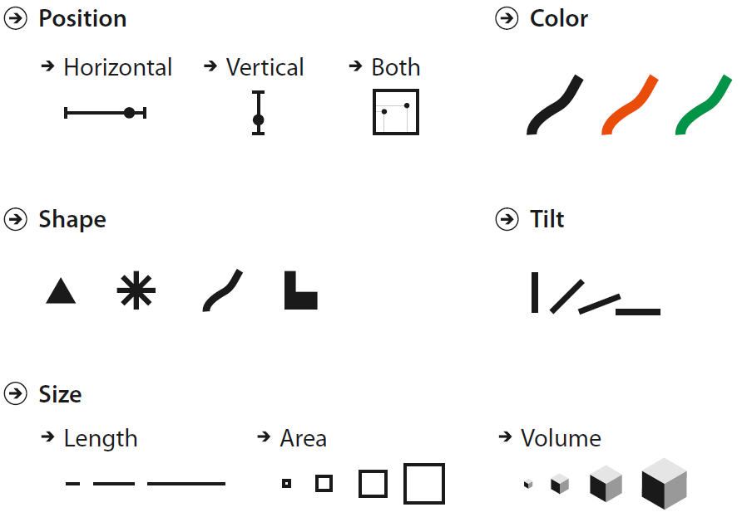
Building Blocks: Marks and Channels
Marks
Represent individual items
Represent links between items
Channels
Control appearance of marks
Mapped to attributes of items

Slide 20

Analyze Idiom Structure
Bar chart
Mark: line
Channel: Horizontal position
Size (length)
Scatterplot
Mark: point
Channel: Horizontal position
Vertical position
Encode 2 attributes
Scatterplot
Mark: point
Channel: Horizontal position
Vertical position
Color hue
Encode 3 attributes
Scatterplot
Mark: point
Channel: Horizontal position
Vertical position
Color hue
Size (area)
Encode 4 attributes
Encode 2 attributes

Slide 21
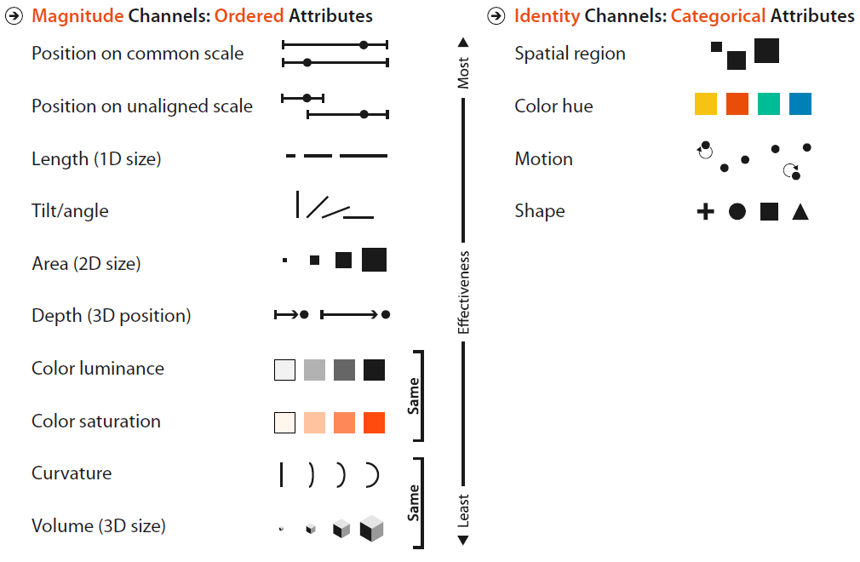
Channels Types
Identity channels
Tell us information about what something is or where it is
What shape we see? Where is the region?
Magnitude channels
Tell us information about how much of something there is
How much longer is this line than that line? How much space between lines? etc.

Slide 22
Using Marks and Channels
All channels are not equal
Same data attribute encoded with two different channel will result with different information content in our head
Use of marks and channels guided by two principles
Expressiveness principle
Effectiveness principle

Slide 23
Expressiveness Principle
Match channel and data characteristics
Unordered data
Should not implies an ordering that does not exist
Use identity channels
Ordered data
Our perceptual system should intrinsically sense an ordered
Use magnitude channels
Categorical Attributes (color, profession, …)
Ordered Attributes
Ordinal (high-med-low, grades, …)
Quantitative (temperature, height, weight, …)

Slide 24
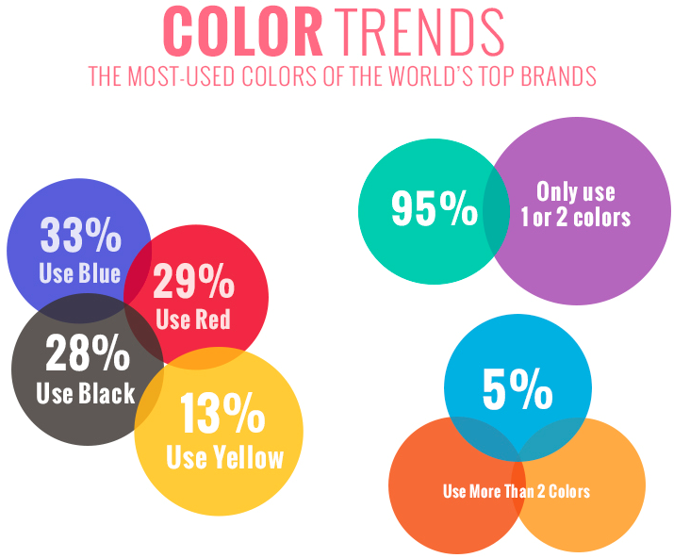
Expressiveness Principle – Example
Correctly used channels
Spatial position to group information
Color Hue to identify used colors
Incorrectly used channels
Color Hue to encode multiple attributes
Size of the circle has no meaning

Slide 25
Effectiveness Principle
Encode most important attributes with highest ranked channels
Decreasingly important attributes can be matched with less effective channels

Slide 26
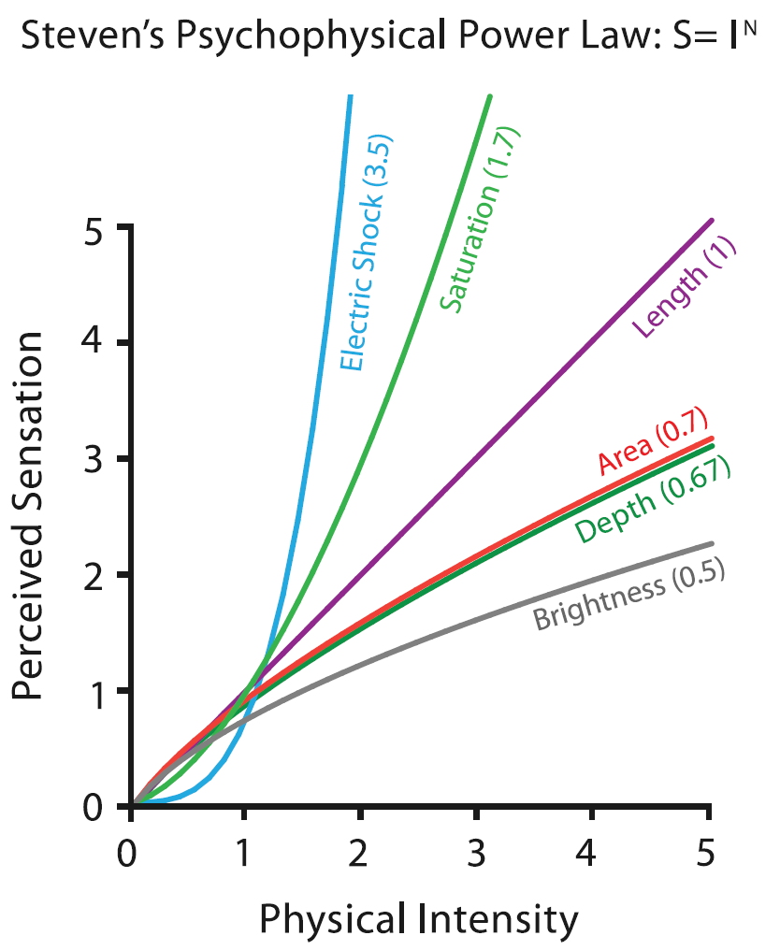
How the Channels are Ranked
Accuracy is used to quantify effectiveness
How close is human perceptual judgement to some objective measurement of the stimulus
Psychophysics
Subfield of psychology devoted to the systematic measurement of general human perception
Psychophysical Power Law of Stevens

Slide 27
Channel Rankings
Expressiveness principle
Match channel and data characteristics
Effectiveness principle
Encode most important attributes with highest ranked channels
Spatial position ranks high for both

Slide 28
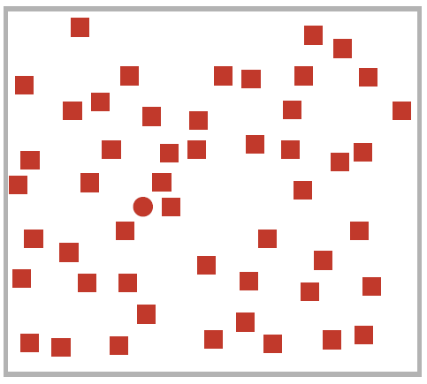
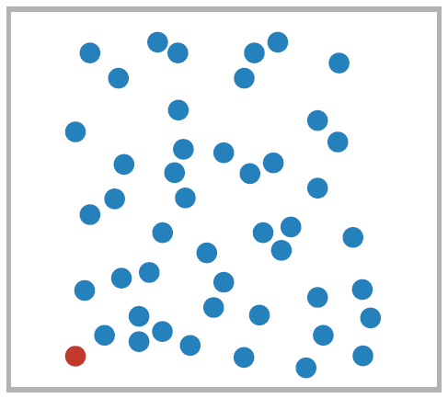
Channel Rankings – Identity Channels
Color Hue encoding > Shape encoding

Slide 29
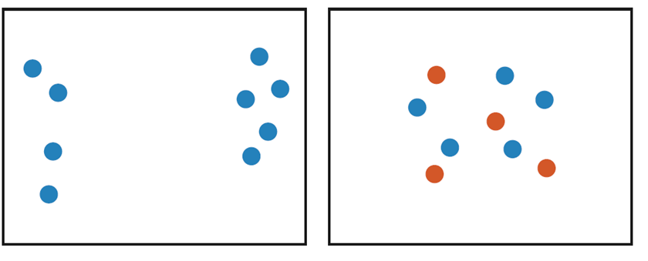
Channel Rankings – Identity Channels
Spatial region encoding > Color hue encoding

Slide 30
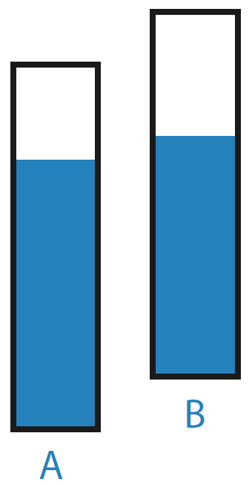
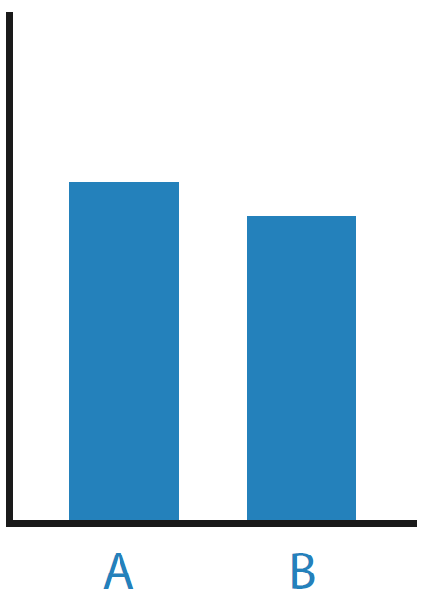
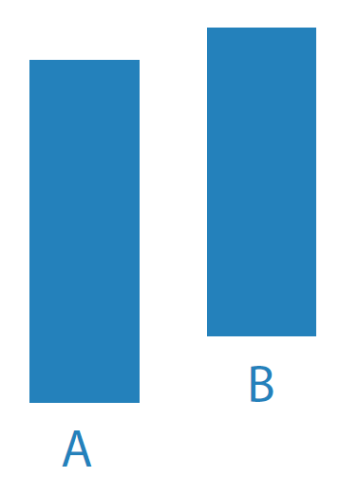
Channel Rankings – Magnitude Channels
Position on common scale > Position on unaligned scale > Length

Slide 31
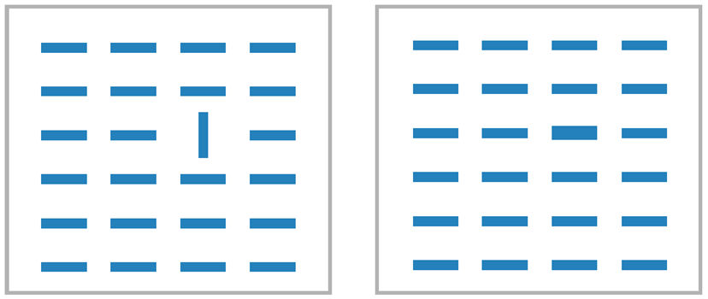
Channel Rankings – Magnitude Channels
Tilt encoding > Area (2D Size) encoding

